Slide 1
Cursor
Lecturer: Ngo Huy Bien
Software Engineering Department
Faculty of Information Technology
VNUHCM - University of Science
Ho Chi Minh City, Vietnam
nhbien@fit.hcmus.edu.vn

Slide 2

Objectives

Slide 3

Contents
Cursor.

Slide 4

References

Slide 5
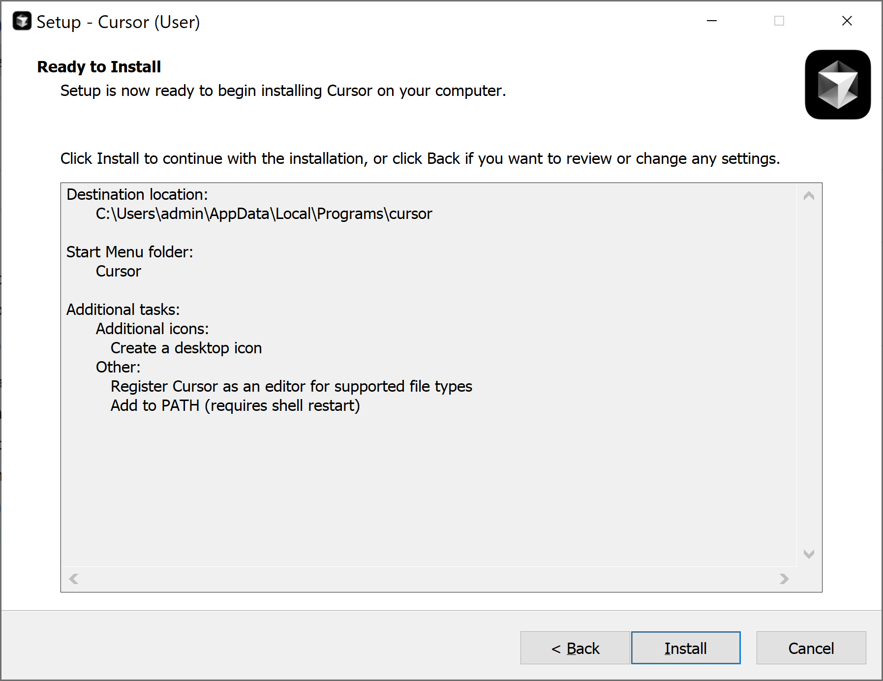
1. Install Cursor
https://www.cursor.com/

Slide 6
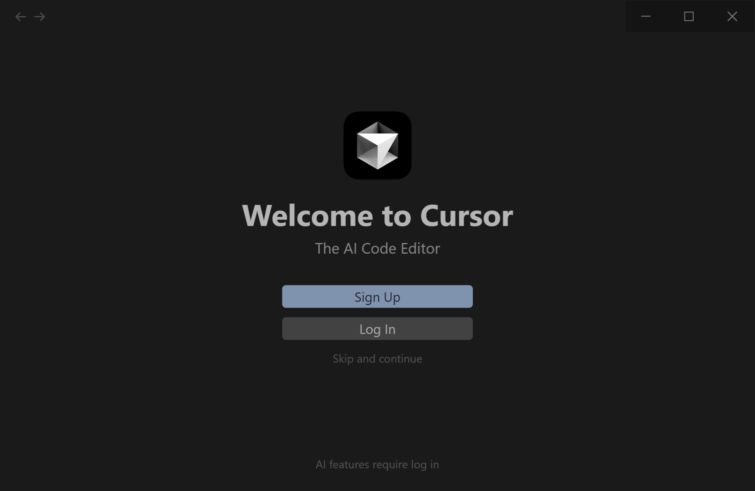
2. Log in Cursor to Enable AI

Slide 7
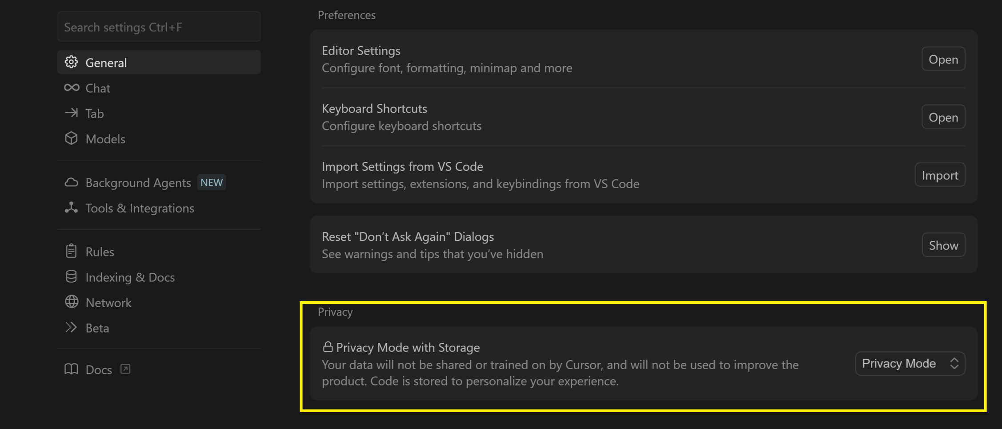
3. Configure Privacy

Slide 8
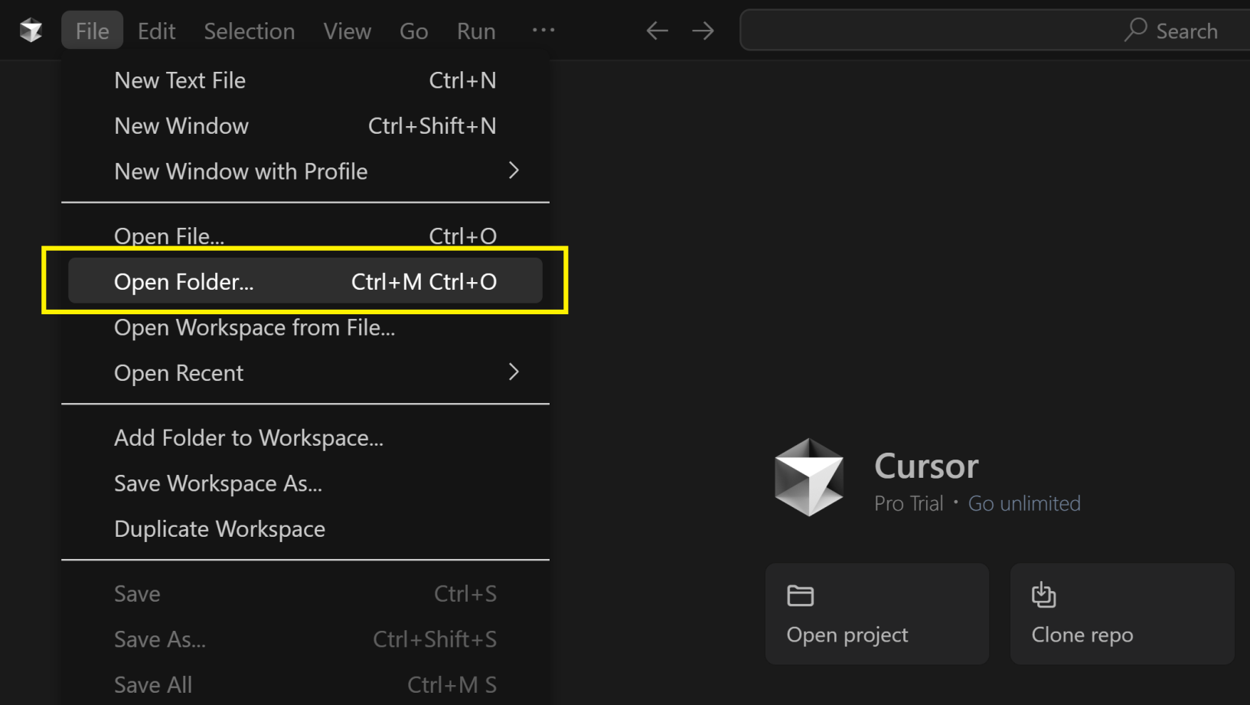
4. Open an Empty Folder

Slide 9
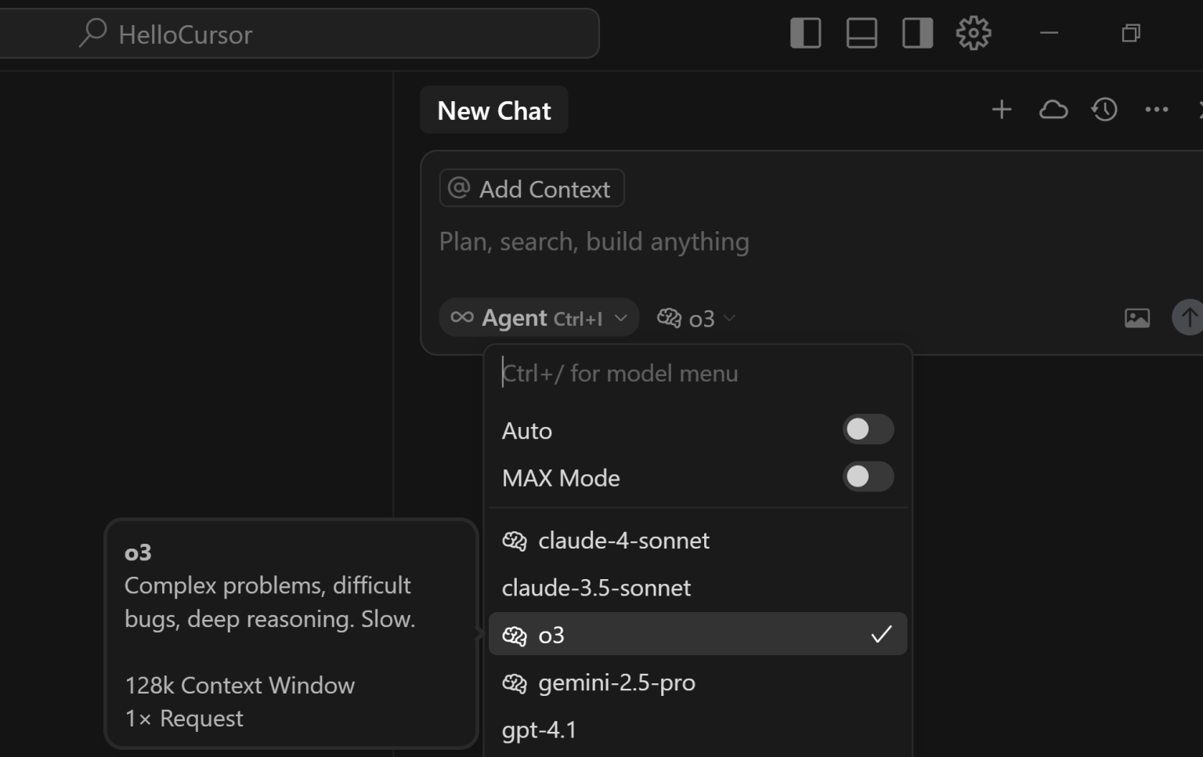
5. Select Model

Slide 10
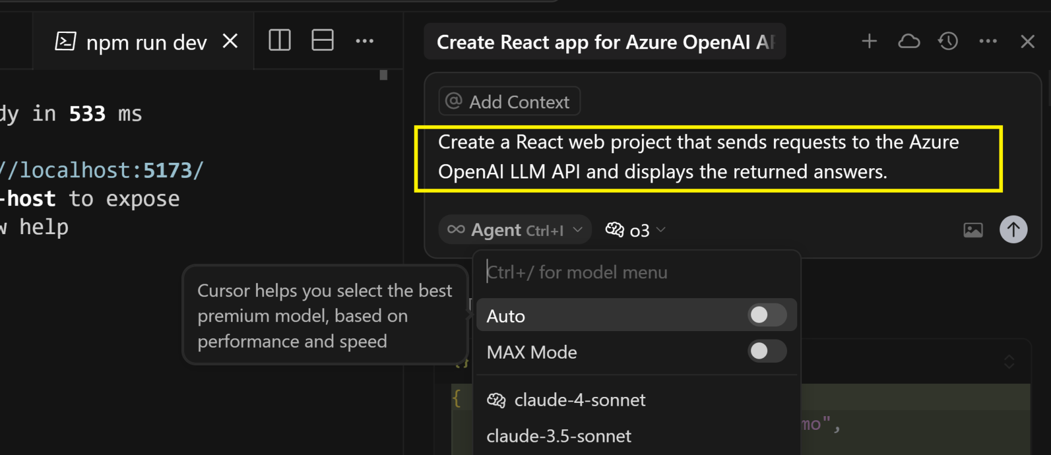
6. Create Hello World (LLM Client)
Create a React web project that sends requests to the Azure OpenAI LLM API and displays the returned answers.

Slide 11
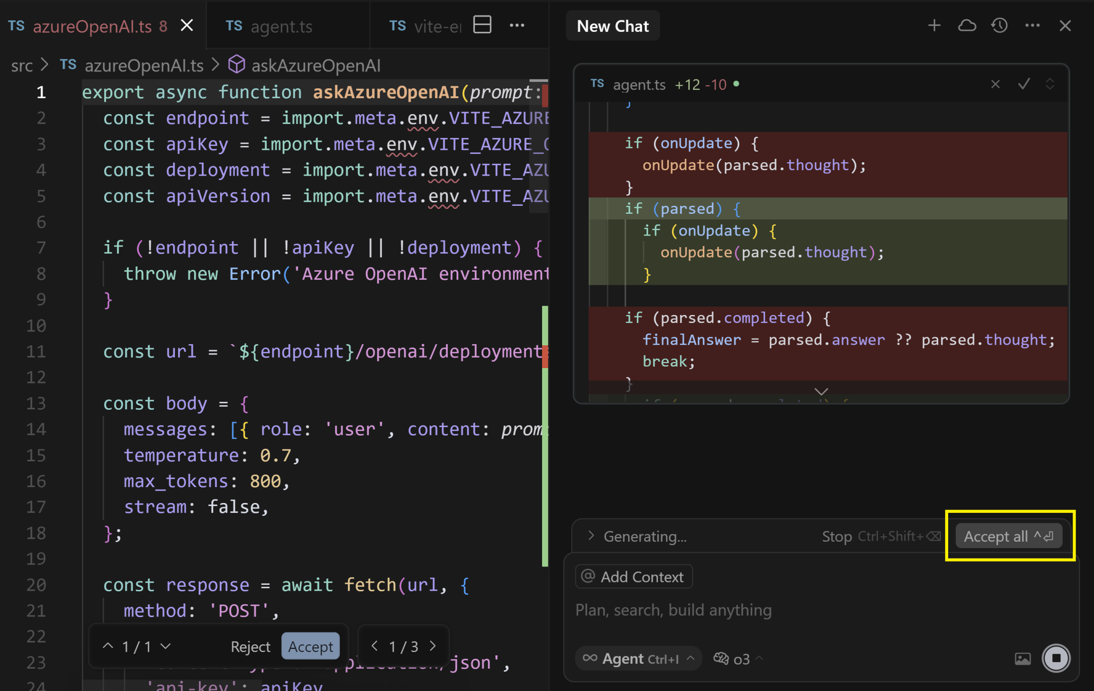
7. Confirm Action

Slide 12


Slide 13
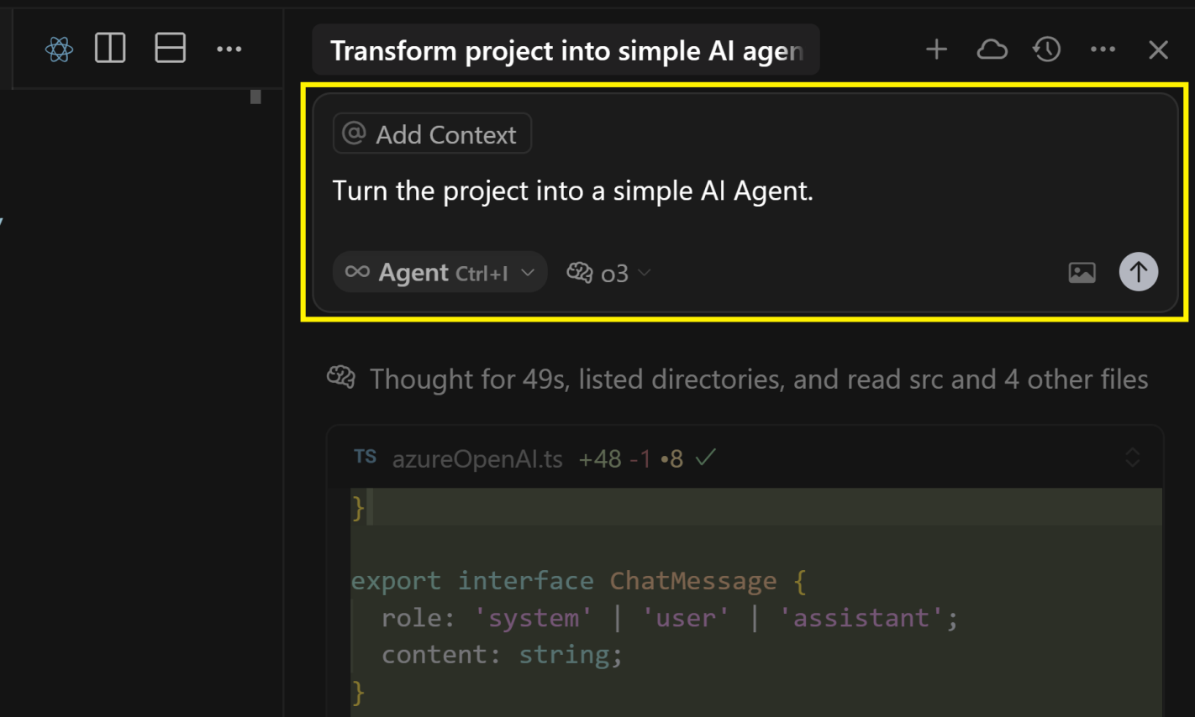
1. Make a Change
Turn the project into a simple AI Agent.

Slide 14
2. Refining UI Layouts
Turn the project into a simple AI Agent.
Design the user interface to closely resemble the ChatGPT UI.
Make the agent function as an Agent that consistently rewrites whatever the user inputs.
Ensure the main UI fully stretches to the width of the browser.
Please use an attractive icon for the send button.
Make sure the height of the Send button matches the height of the input text field.
Increase the width of the send button to twice its current size.
Make sure the message is sent when the Enter key is pressed.

Slide 15
3. Adjust UI Colors
Please use an Azure blue color for the header background.
Please use an Azure blue color for the send button.
Please set the footer background color to white.
Please set the background color to white.
Please update the text area's background to a color that complements the azure style.
Revert the last step back.
Align the questions to the right side of the message list panel.
Ensure the questions and answers background fully stretch to the width of their container, and their container fully stretches to 90% the width of the browser.

Slide 16
4. Round the Box Corners
Make sure the message list does not display a horizontal scrollbar.
Ensure that the question container automatically adjusts its width to fit its content, but does not exceed half the width of its parent container.
Please set the background color of the questions to the complementary color of azure, and use a highly contrasting color for the text to ensure readability.
Use black.
Make the container for the questions resemble a bubble area.
All the corners should be rounded.

Slide 17
5. Add a Clear Content Button
Add a "Clear" button that matches the style of the Send button. This button should remove all content when clicked.
Change "Azure OpenAI Agent Demo" to "Azure OpenAI Agent Demo: Rewrite Text"
Shift the questions 10px to the left from the right edge.
Change app title to "Azure OpenAI Agent Demo: Text Rewriting".

Slide 19
1. Convert the Project to .NET Stack
Create a new folder named "DotNetVersion", then convert the project to use the React frontend and .NET Framework 4.8.1 backend stack. Store all converted files in this folder.
The DotnetVersion.API should be built on the .NET Framework 4.8.1 stack, not the .NET 9.0 stack.
Remove Hello, and set C# version to 7.3.
Error CS8370: Feature ' using declarations' is not available in C# 7.3
The DotNetVersion.API should call the Azure Open AI API and provide the same features as the Node.js project.
error CS0656: Missing compiler required member 'Microsoft.CSharp.RuntimeBinder.CSharpArgumentInfo.Create'

Slide 20
2. Fix Enviroment Issues
Error: Azure OpenAI environment variables are not set.
Create a Windows batch script that sets credentials, and update the code to use environment variables for storing secrets.
Add debug code to the GET http://localhost:5000/api/openai/rewrite endpoint to display the credentials.

Slide 21
3. Fix Readme
Update readme for building and running the project. Assume that msbuild locates at "C:\Program Files\Microsoft Visual Studio\2022\Professional\MSBuild\Current\Bin\MSBuild.exe"
Use cmd instead of powersell. Ensure the set-openai-env.bat is used.
Assume that DotNetVersion is the root and current folder.

Slide 22
4. Generate Documentation
Generate documentation comments for the AzureOpenAIService.cs file.
Remove all documentation comments from the AzureOpenAIService.cs file.
Update all variable names in the AzureOpenAIService.cs file to follow camelCase naming convention.

Slide 23
5. Create Unit Tests
Write NUnit unit tests for the AzureOpenAIService.cs class.
Set the Unit Test project to target .NET Framework 4.8.1, and use NUnit version 2.4.0.2.
Eliminate the dependency on NUnit2TestAdapter.
Update all variable names in the AzureOpenAIServiceTests.cs file to follow camelCase naming convention.
Update AzureOpenAIServiceTests.cs to use NUnit version 2.4.0.2.
Remove the stub and use actual HTTP requests in the test code.
System.Net.WebException : The underlying connection was closed: An unexpected error occurred on a receive.
Update build-and-run-unit-tests.bat to execute the unit tests, assuming the NUnit root directory is located at 'C:\Program Files (x86)\NUnit-2.7.1\bin'.

Slide 24
6. Create Dockerfile
Please ask me questions to help generate a Dockerfile for the backend.

Slide 25

Thank You & See You Again

